Slide 1
Machine Learning

Slide 2
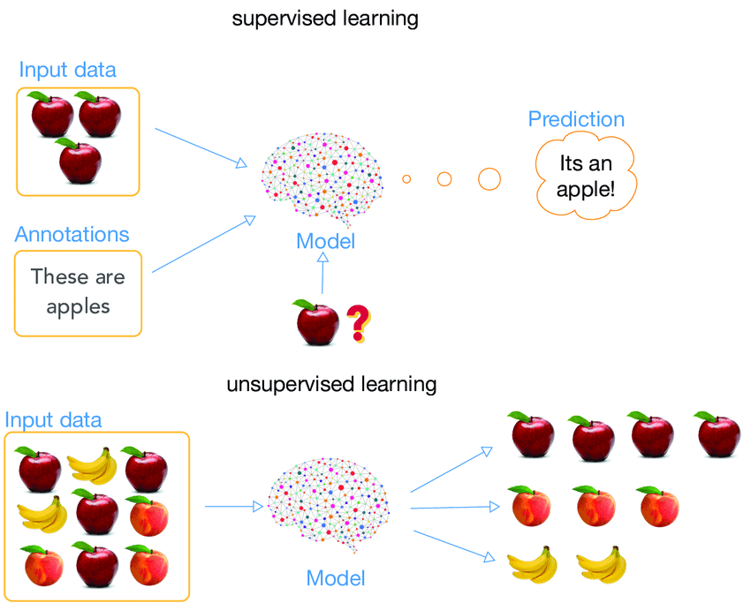
Supervised Learning and Unsupervised Learning

Slide 3
Supervised Learning
Regression
Works on continuous data
Given a value of X determines the Value of Y where Y is dependent on X
Example: House price prediction, sales prediction
Classification
Task of identifying the label or class of the data
Works on the discrete data
Example Dog & Cat classification,

Slide 4
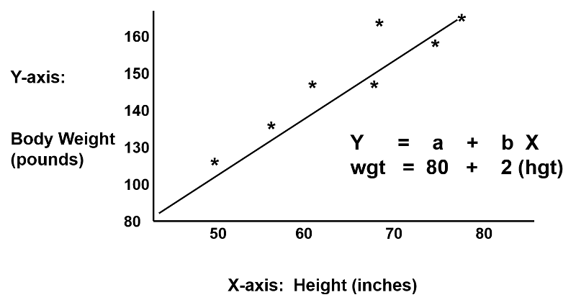
Linear Regression

Slide 5
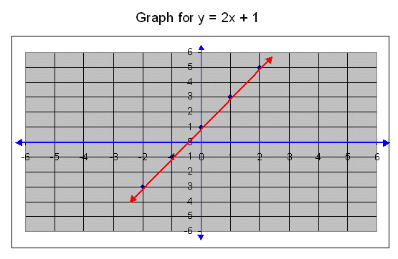
Linear Regression
Y is a continuous data. We have to predict using a function. So what function will best fit the line?
X | 1 | 2 | 3 | 4 | 5 | 6 | 7
Y | 3 | 5 | 7 | 9 | 11 | 13 | ????
Y = 2X+1 (equation of st.line)

Slide 6
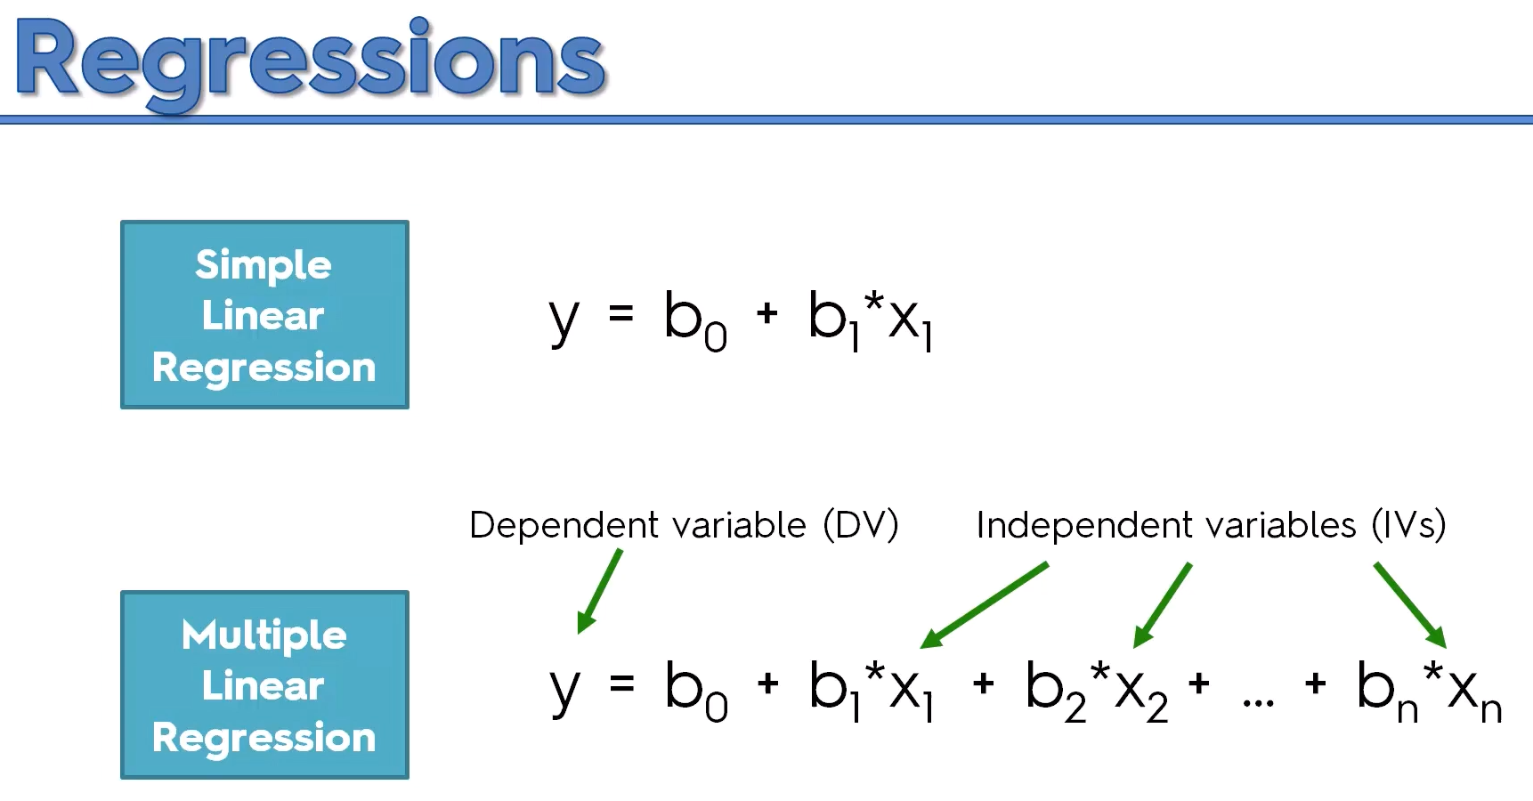

Slide 7
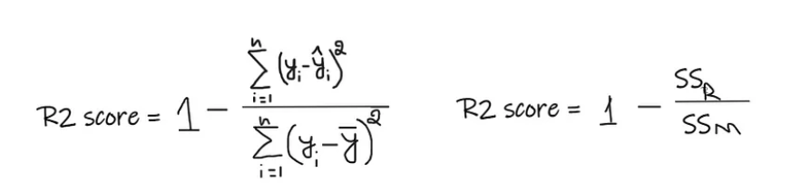
Evaluation Metrics
Regression
R2 score
An R-Squared value shows how well the model predicts the outcome of the dependent variable. R-Squared values range from 0 to 1. An R-Squared value of 0 means that the model explains or predicts 0% of the relationship between the dependent and independent variables.

Slide 8
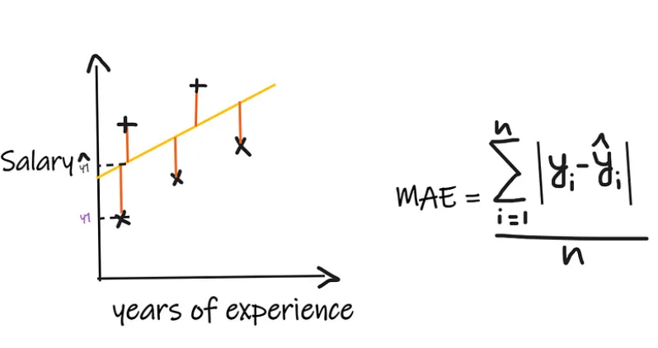
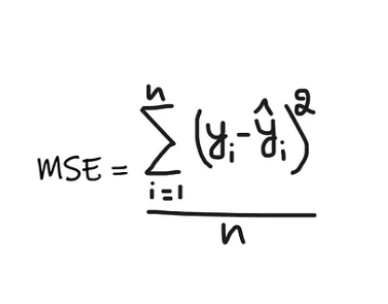
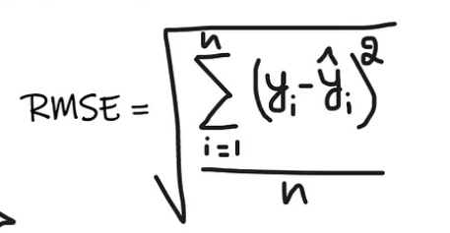
Evaluation Metrics
MAE, MSE, RMSE

Slide 9
Demo

Slide 10
Logistic Regression
Is actually used for classification problem.
For every value of X the hypothesis function Y always lies in between 0 and 1
f(X) = Y=[0,1]

Slide 11

Formula

Slide 12
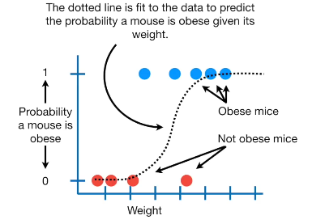
Example

Slide 13
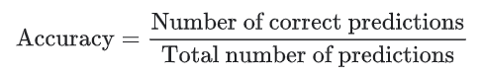
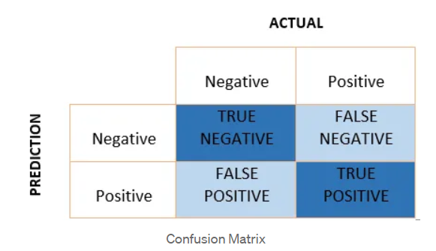
Evaluation Metrics
Classification
Accuracy
Accuracy is one metric for evaluating classification models. Informally, accuracy is the fraction of predictions our model got right.
Confusion Matrix
It is a matrix of size 2×2 for binary classification with actual values on one axis and predicted on another.

Slide 14
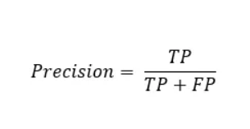
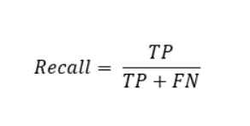
Evaluation Metrics
Classification
Precision
Out of all the positive predicted, what percentage is truly positive.
Recall
Out of the total positive, what percentage are predicted positive. It is the same as TPR (true positive rate).

Slide 15
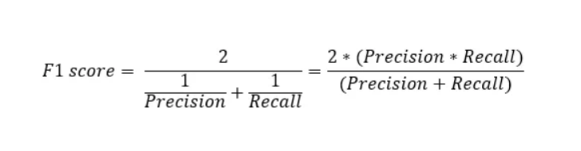
Evaluation Metrics
Classification
F1-Score
It is the harmonic mean of precision and recall. It takes both false positive and false negatives into account. Therefore, it performs well on an imbalanced dataset.

Slide 16
Demo

Slide 17
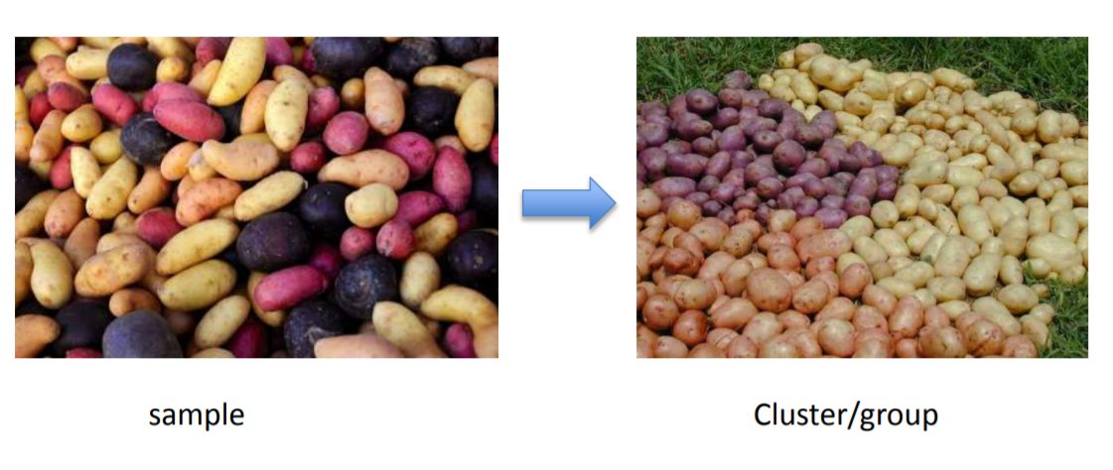
Clustering
Gathering samples into groups of similar samples according to some predefined similarity or dissimilarity measure.

Slide 18
Examples where clustering are used?
Market segmentation - group customers into different market segments.
Social network analysis - Facebook "smartlists"
Organizing computer clusters and data centers for network layout and location
Astronomical data analysis - Understanding galaxy formation

Slide 19
K means Clustering Algorithm
Given k, the k-means algorithm works as follows:
1. Choose k (random) data points (seeds) to be the initial centroids, cluster centers
2. Assign each data point to the closest centroid
3. Re-compute the centroids using the current cluster memberships
4. If a convergence criterion is not met, repeat steps 2 and 3

Slide 20
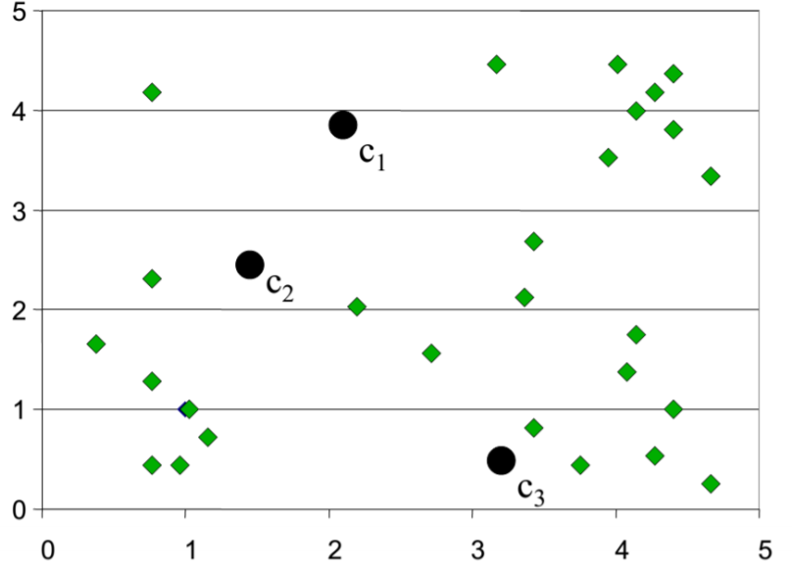
Random Initialization of Cluster Centers

Slide 21
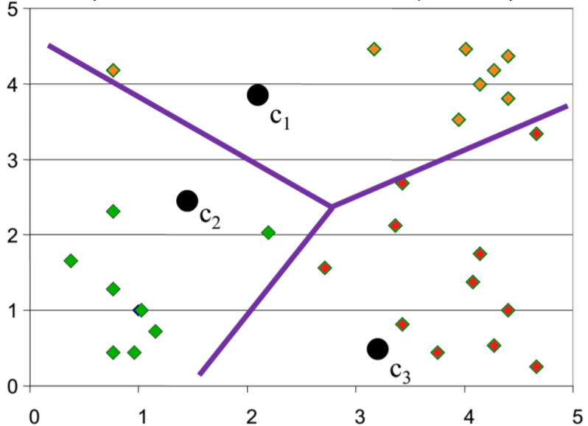
Determination of Cluster membership for each input

Slide 22
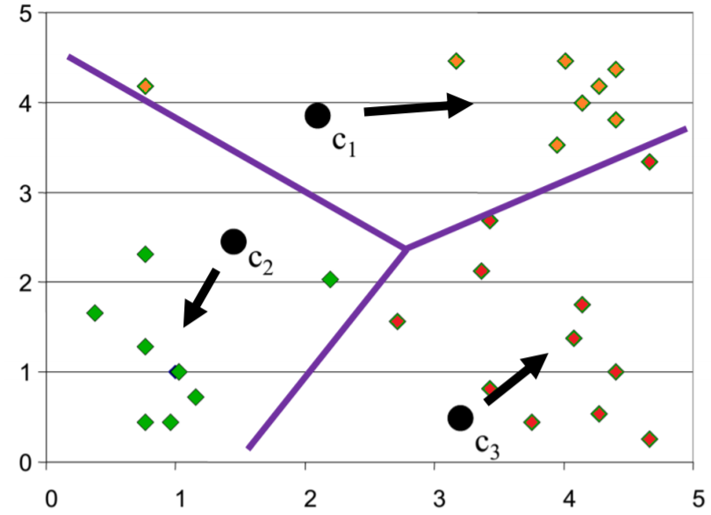
Re-estimation of Cluster Centers

Slide 23
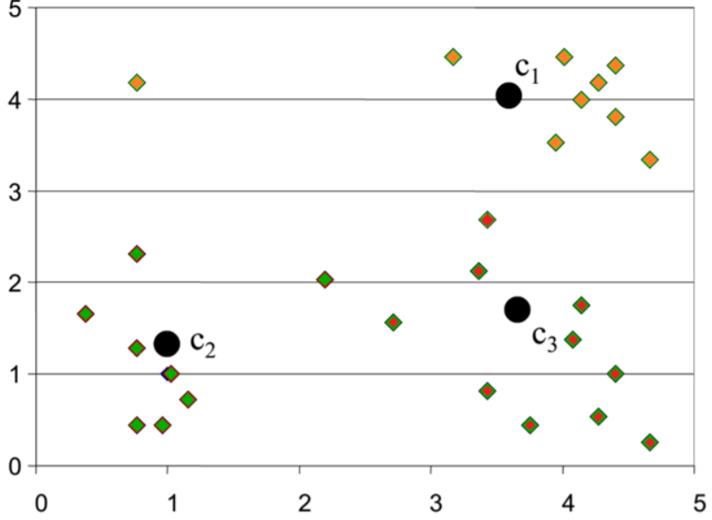
Result from first iteration

Slide 24
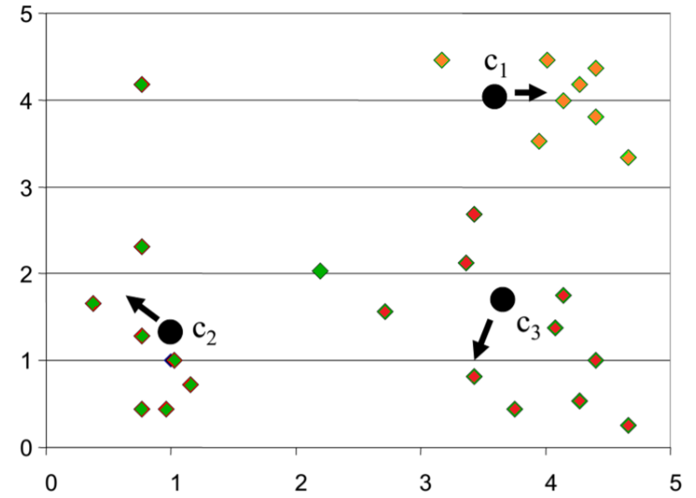
Result from second Iteration

Slide 25
Demo

Slide 26
Decision Tree
Powerful supervised algorithm for both classification and regression
Represent rules in the form of a tree structure which can be understood by humans.

Slide 27
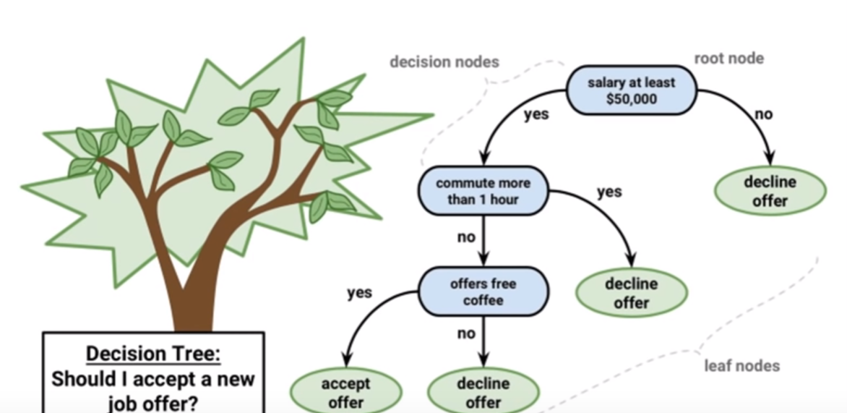
Graphical Representation

Slide 28
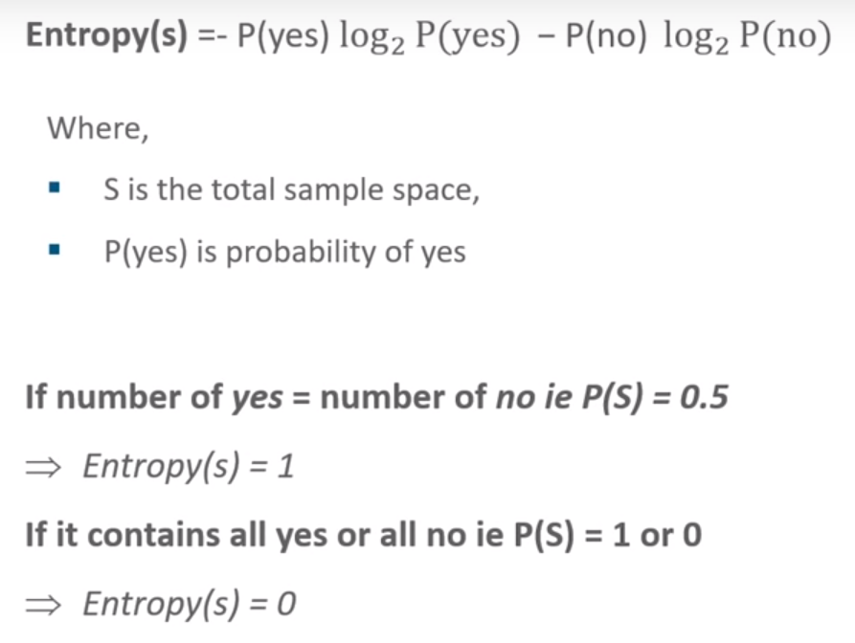
Entropy
Defines randomness(impurity) in data
First step to solve the problem of decision tree

Slide 29
Information Gain
Measures the reduction in entropy
Decides which attribute should be selected as the decision node
If S is our total collection, then
Information Gain = Entropy(S) - [(Weighted Avg) * Entropy(each feature)]

Slide 30
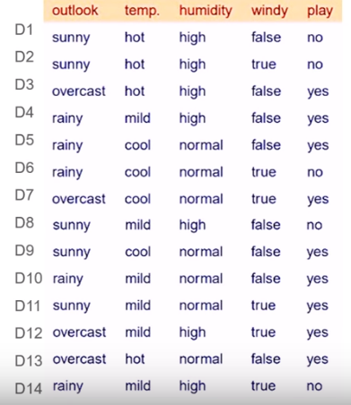
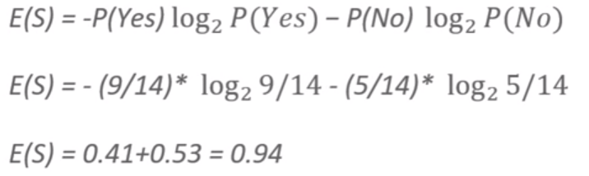
Training data
Computing Entropy for this data

Slide 31
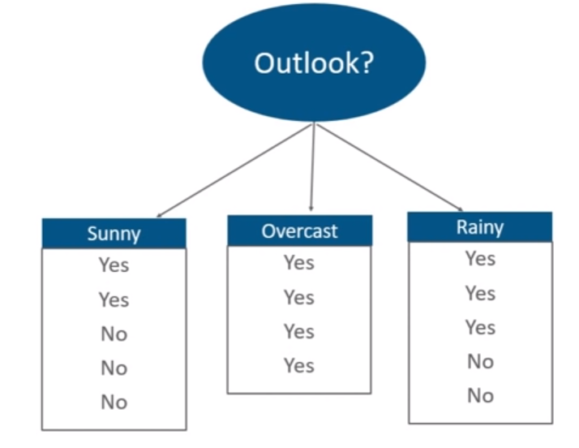
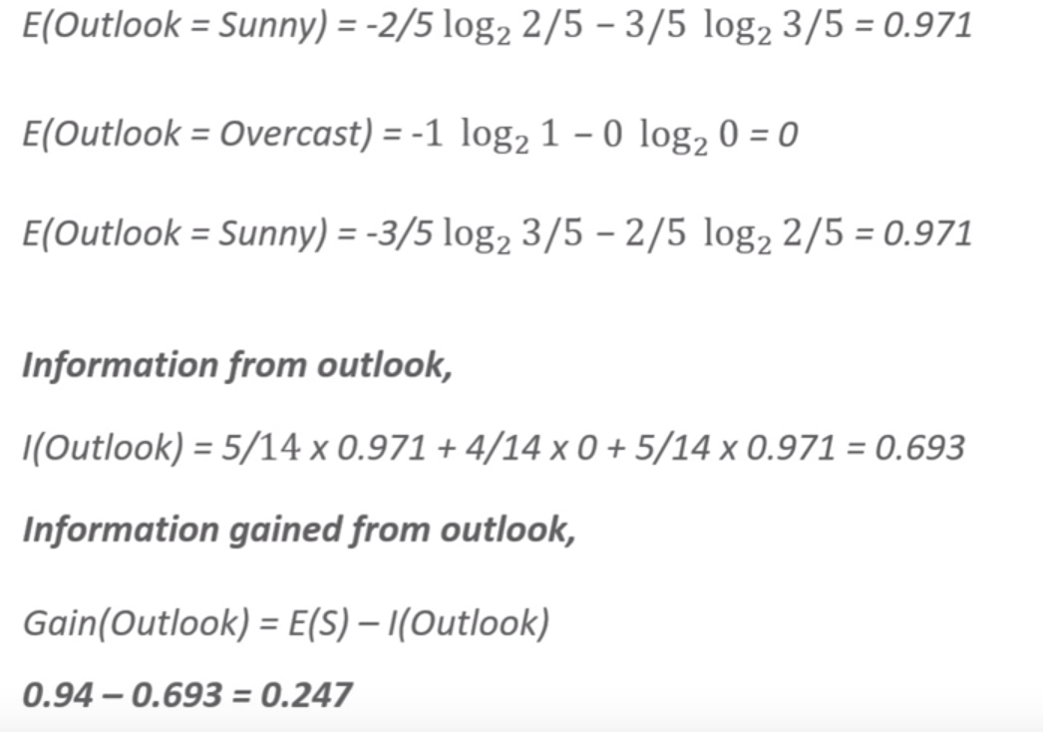
Information Gain for outlook

Slide 32
Information Gain from other attributes
Outlook : 0.247
Temperature : 0.029
Humidity : 0152
Windy : 0.048

Slide 33
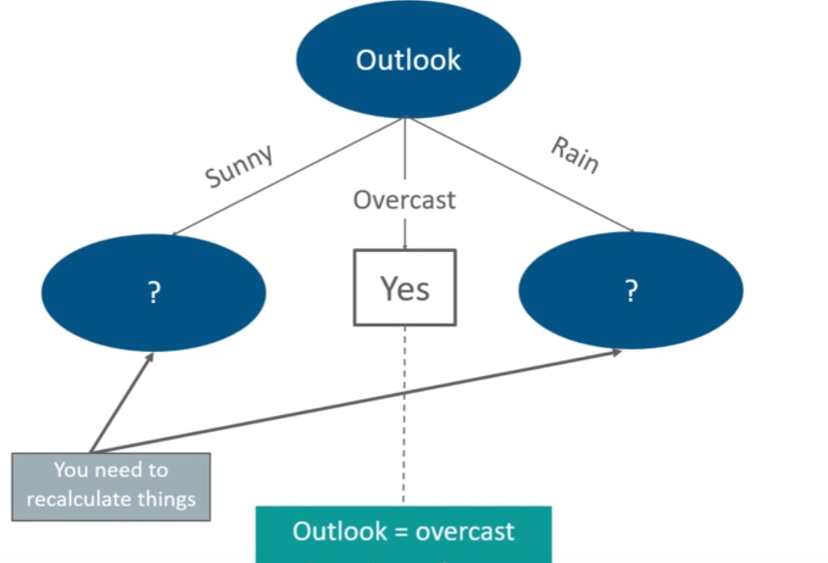
Now our decision tree will build like this

Slide 34
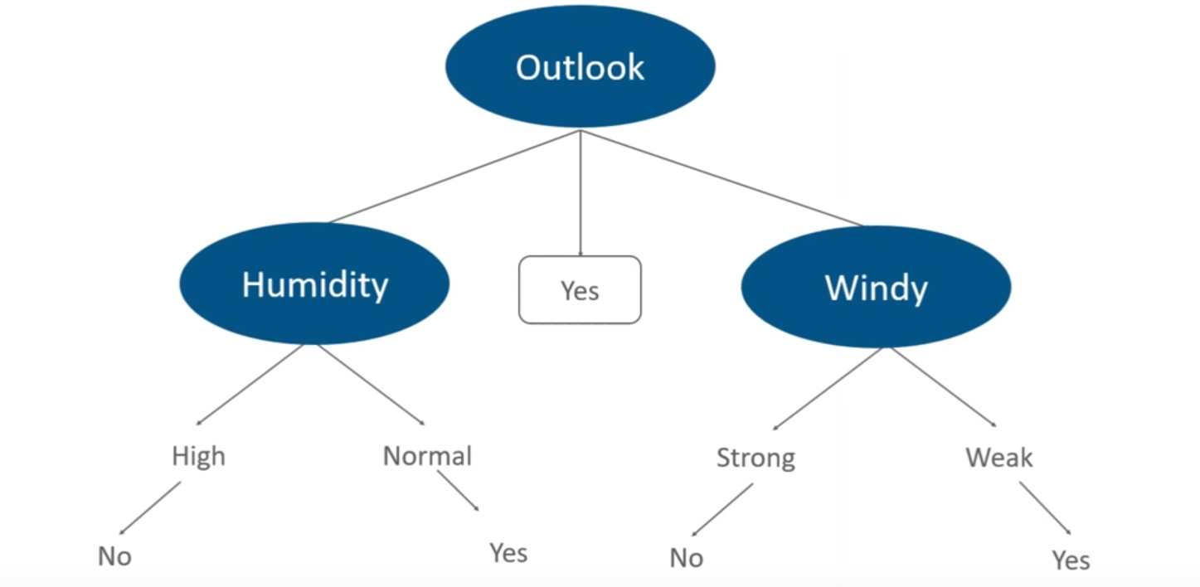
Finally, our decision tree will look like

Slide 35
Demo

Slide 36
Ensemble Methods
Ensemble learning helps improve machine learning results by combining several models.
We can use these techniques for regression as well as classification problems.
The final prediction from these ensembling techniques is obtained by combining results from several base models.
Averaging, voting and stacking are some of the ways the results are combined to obtain a final prediction

Slide 37
Types of Ensemble Learning
Bagging
Boosting

Slide 38
Implementation Steps of Bagging
Step 1: Multiple subsets are made from the original information set with identical tuples, deciding on observations with replacement.
Step 2: A base model is created on all subsets.
Step 3: Every version is found in parallel with each training set and unbiased.
Step 4: The very last predictions are determined by combining the forecasts from all models.

Slide 39
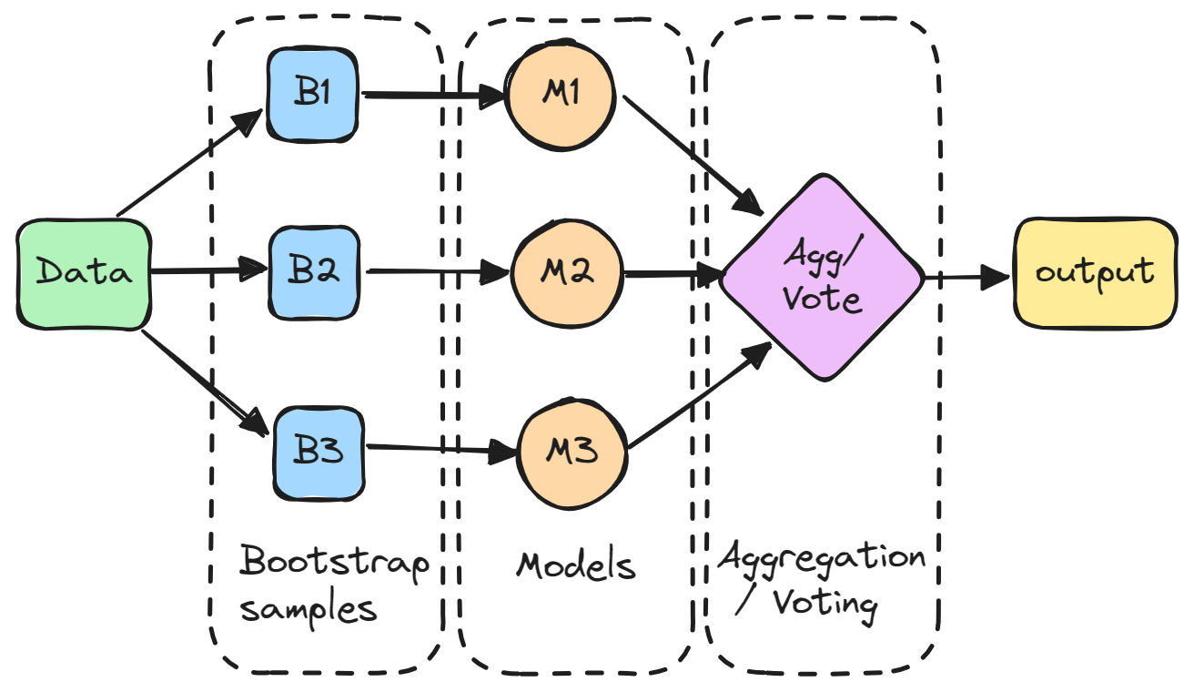
Bagging

Slide 40
Benefits of Bagging
Reduce Overfitting
Improve Accuracy
Handles Unstable Models

Slide 41
Cons
Increased Complexity and Computational Cost
Each model needs to be trained and stored, which can be computationally expensive

Slide 42
Boosting
Boosting is an ensemble modeling technique that attempts to build a strong classifier from the number of weak classifiers.
The main idea behind boosting is to iteratively train weak models on different subsets of the training data
It is done by building a model by using weak models in series.
models are designed to focus more on the examples that the previous models struggled to classify correctly

Slide 43
Implementation Steps of Boosting
1. Initialize weights
At the start of the process, each training example is given equal weight.
2. Train a weak learner
The weighted training data is used to train a weak learner.
3. Error calculation:
The error of the weak learner on the training data is computed.

Slide 44
Implementation Steps of Boosting
4. Update weights
Weights are updated according to the mistake rate of the training examples.
Misclassified examples are given higher weights, whereas correctly classified examples are given lower weights.
5. Repeat
Steps 2–4 are repeated several times. A new weak learner is trained on the updated weights of the training examples in each cycle.

Slide 45
Implementation Steps of Boosting
6. Combine weak learners
The final model is made up of all of the weak learners that were trained in the preceding steps.
The accuracy of each weak learner is weighted, and the final prediction is based on the weighted total of the weak learners.
7. Forecast
The finished model is used to forecast fresh instances’ class labels.

Slide 46
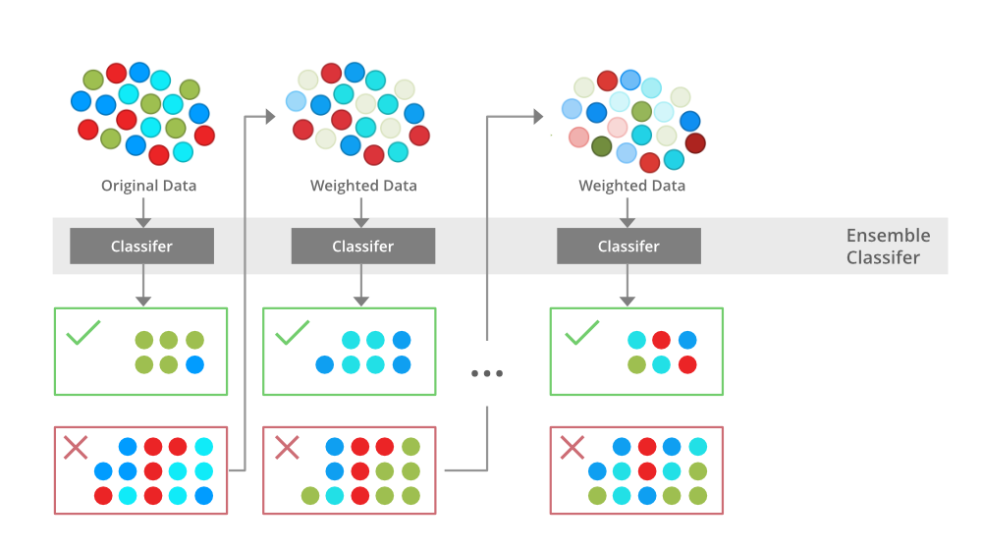
Boosting

Slide 47
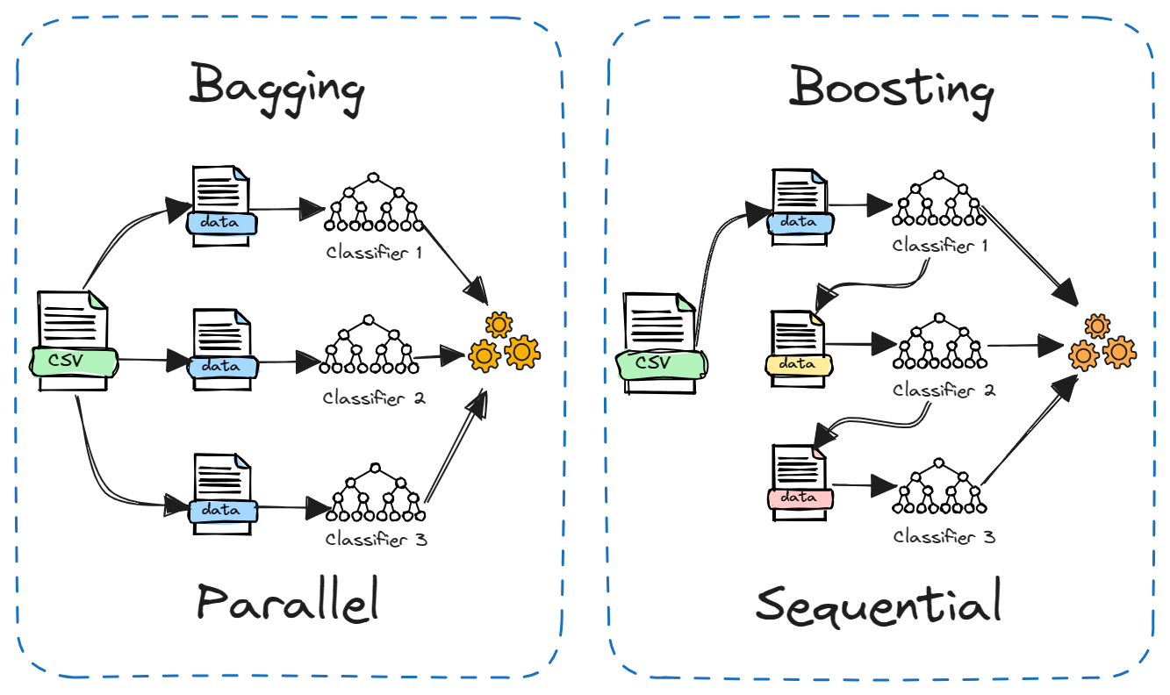
Differences Figuratively

Slide 48
Demo

Slide 49
Terminologies used in SVM
Support vector
The vector points closest to the hyperplane
SVMs are named after these support vectors
Hyperplane
In SVM, the hyperplane is the decision boundary in the feature space
The dimension of the hyperplane depends upon the number of features
If the number of input features is two, then the hyperplane is just a line
If the number of input features is three, then the hyperplane becomes a 2-D plane

Slide 50
Margin
it is the distance between the hyperplane and the observations closest to the hyperplane (support vectors)
In SVM large margin is considered a good margin
Hard Margin
If the training data is linearly separable,
we can select two parallel hyperplanes that separate the two classes of data
so that the distance between them is as large as possible

Slide 51
Soft Margin
As most of the real-world data are not fully linearly separable
we will allow some margin violation to occur
It is better to have a large margin, even though some constraints are violated
Margin violation means choosing a hyperplane, which can allow some data points to stay in either the incorrect side of the hyperplane

Slide 52
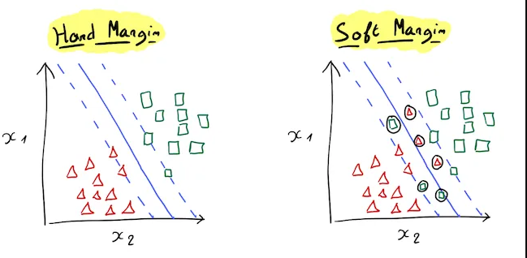

Slide 53

SVM working mechanisms

Slide 54
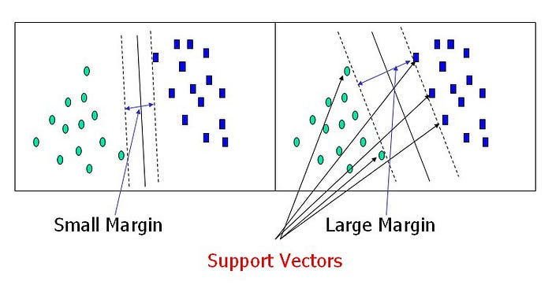

Slide 55
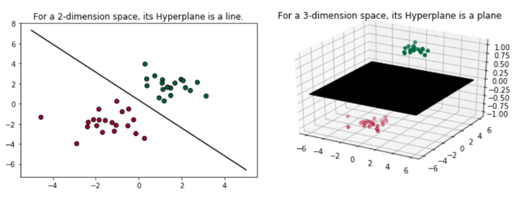
2D and 3D dimensional space

Slide 56
Types of Support Vector Machines
Linear SVM
use a linear decision boundary to separate the data points of different classes
a single straight line can entirely divide the data points into their respective classes
Non-Linear SVM
used to classify data when it cannot be separated into two classes by a straight line
using kernel functions, nonlinear SVMs can handle nonlinearly separable data (gaussian kernel, sigmoid & polynomial kernel)
A linear SVM is used to locate a nonlinear decision boundary in this modified space

Slide 57
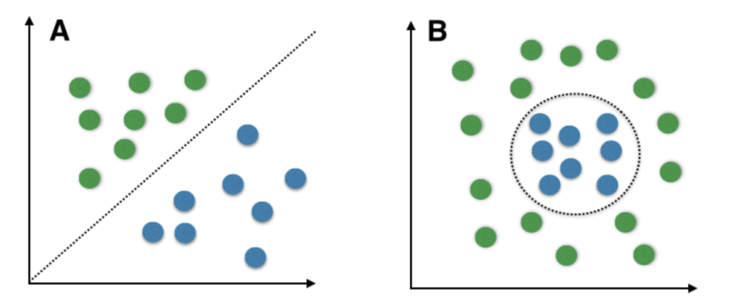
Figure

Slide 58
Pros and Cons of SVM
Pros
Accuracy
Works well on smaller cleaner datasets
More efficient on Higher dimensional spaces
Cons
Isn’t suited to larger datasets as the training time with SVMs can be high
Less effective on noisier datasets with overlapping classes

Slide 59
Applications of SVM in real life
Face Detection
Image Classification
Bio-informatics
Text and hypertext categorization
Handwriting Recognition

Slide 60
Demo

